Slide 1
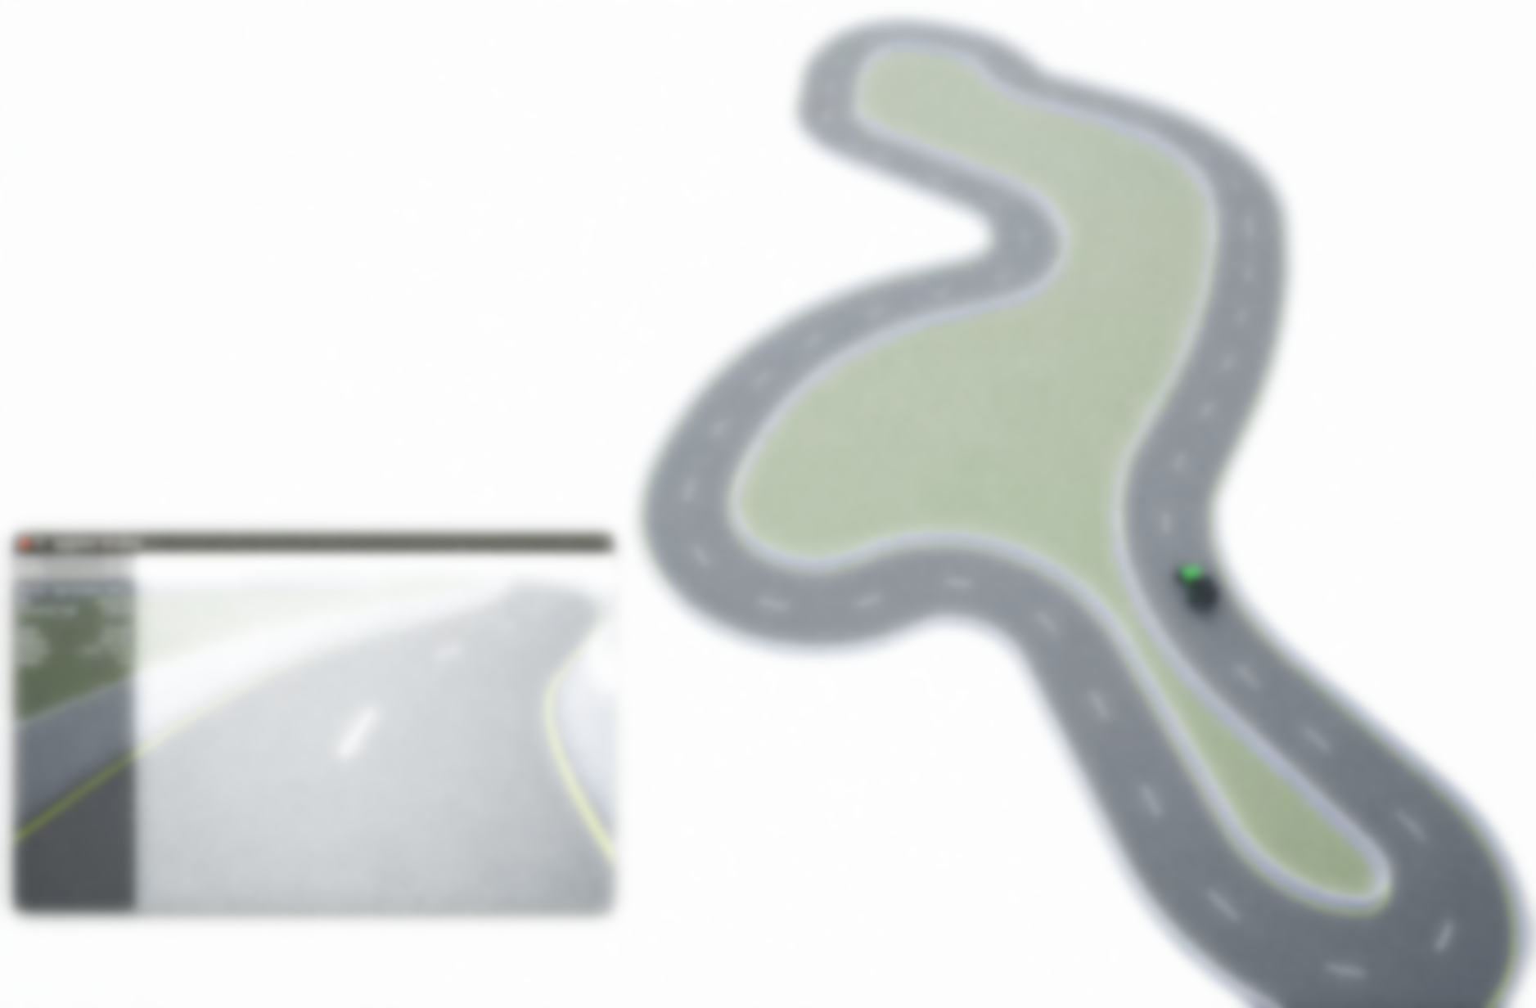
MoCAD: Carla-python Experimental Course
Ⅴ&Ⅵ Deep Reinforcement Learning（DRL）

Slide 2
Outline
Introduce the Deep Reinforcement Learning
Double Deep Q Network (Double-DQN value-based)
Playing Carla with Double-DQN
Deep Deterministic Policy Gradient (DDPG Policy Gradient )
Playing Carla with DDPG
Notes:
介绍DRL， 两种方法playing the carla。
这两节课主要是介绍方法，如何在carla中使用，Carla 作为交互的工具，simulator tool ！

Slide 3
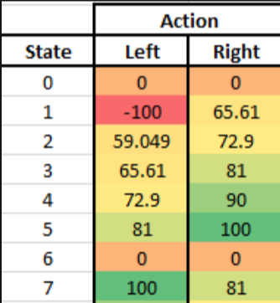
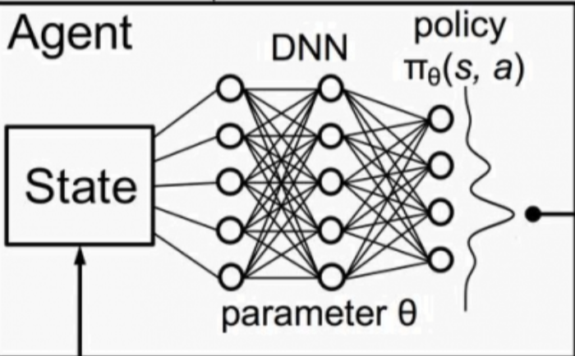
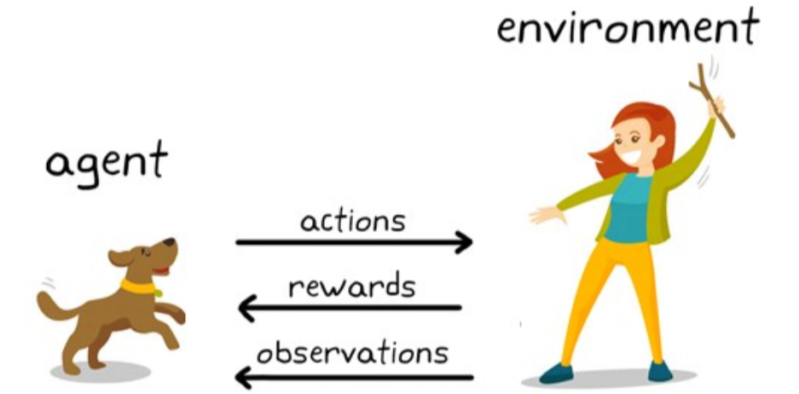
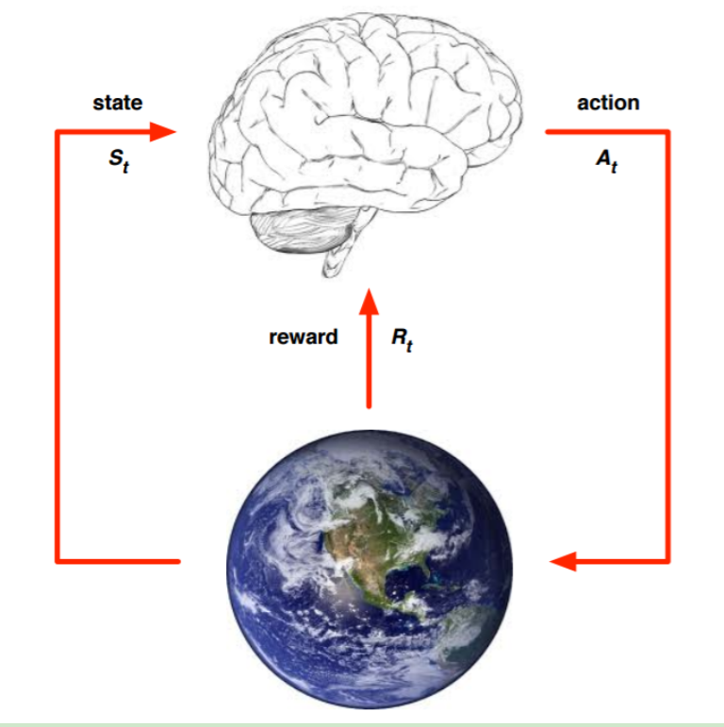
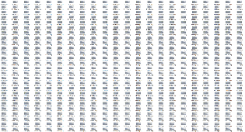
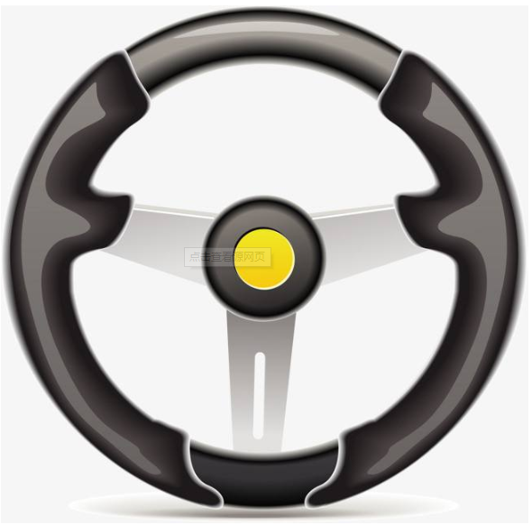
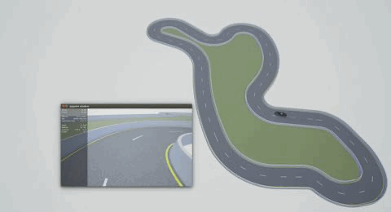
1. Deep Reinforcement Learning
Investigation:
Have you heard of reinforcement learning ?
Know how RL works ?
RL algorithm: DQN, Double-DQN ,Dueling DQN, Actor – Critic, DDPG ?
Reproduce the algorithm by python ?
Descript RL Process :
Markov Decision Process
RL → Deep RL
What is RL ?
Agent
Let the robot learn strategies (Maximum total reward) by interacting with the environment .
Carla
MDP: <S,A,P,R,γ>
Notes:
First, I want to know how many people have heard of RL ? And know RL how to work ? RL algorithm ? …
I will introduce RL simply
RL: strategy and max total reward
Process use the MDP:
Core conceptions: env, state, agent and action
RL的目的：通过和环境的交互让机器人自己学习到策略
Let the robot learn strategies by interacting with the environment
智能体和环境的交互过程中如何获取最大收益$v_{π}\left(s\right)$；PG/Value-based
“如何”即学习到的策略$π$；
MDP描述，几个核心的概念, agent, state, action, reward

Slide 4
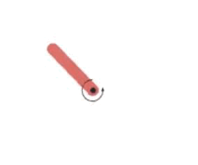

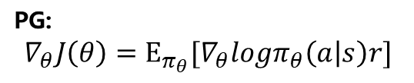
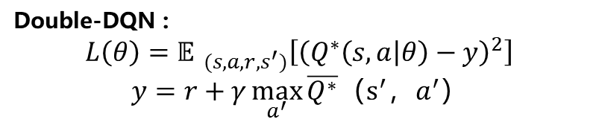
1. Deep Reinforcement Learning
DRL algorithms:
Value-based RL (Max the total reward)
Policy Gradient (Strategies)
Action discrete
Action Continuous
Double-DQN :
$$L\left(θ\right)={𝔼 }_{(s, a,r,s^{′})}\left[{\left(Q^{∗}\left(s,a | θ\right)−y\right)}^{2}\right]$$
$$y=r+γ\max_{a^{′}}{\overline{Q^{∗}}{（s^{′}，a}^{′}）}$$
PG:
$$∇_{θ}J\left(θ\right)=Ε_{π_{θ}}[∇_{θ}logπ_{θ}\left(a | s\right)r]$$
Basic PG algorithm:
REINFORNCE: Monte Carlo ;
Actor-Critic: TD-error ;
Improved Algorithm：
Fixed target
Double DQN
Dueling DQN
Improved Algorithm：
More actors A2C, A3C
Replay buffer PPO DDPG
Instance：
Action: torque = [-2, 2]
Instance：
Action = [‘Up’, ‘down’, ‘left’, ‘right’]
Notes:
The popular value-base algorithm is DQN.
使用DQN 控制vehicle in carla

Slide 5
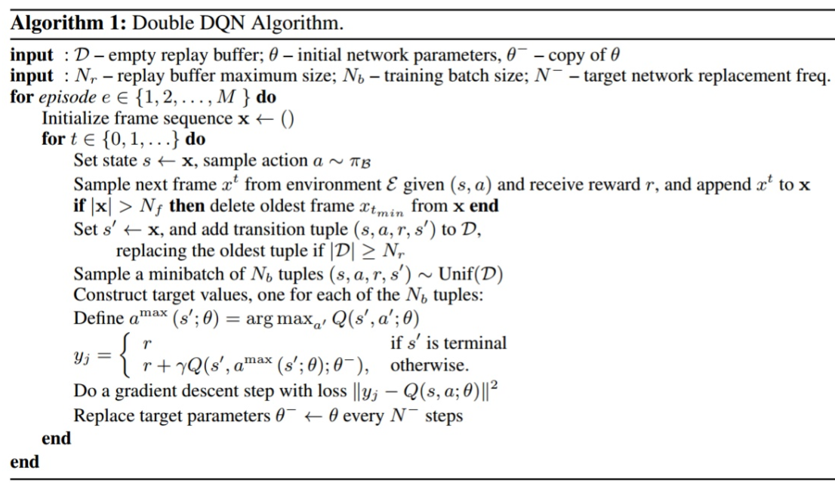
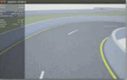
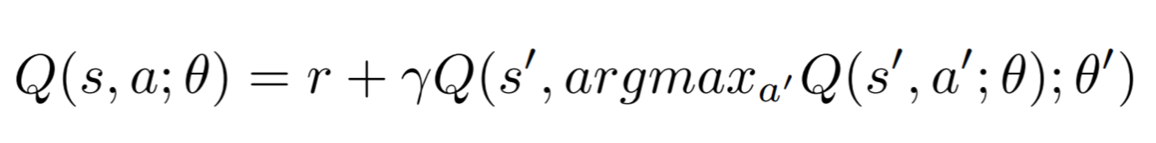
2. Value-based: DQN
Project Analysis：
Goal：Vehicle runs on the race road by itself.
Double-DQN (Intuitively)
Two sub-project:
Carla environment &
Policy by Double DQN
Epsilon—greedy
Carla Env
Replay buffer: Transition
Agent (Vehicle)
Y label
Loss function
actions
Neural Network
State (rgb-image sensor)
Y label
Action (steer, brake, throttle)
Double
Reward
Next state Q-value
Notes:
DQN:训练网络使Q-value（state，action）
Why: double over-estimate …

Slide 6
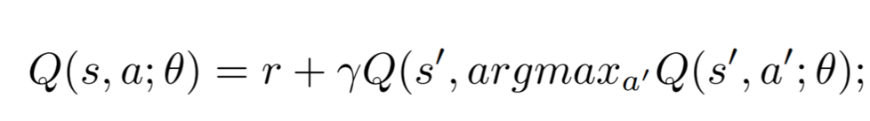
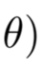
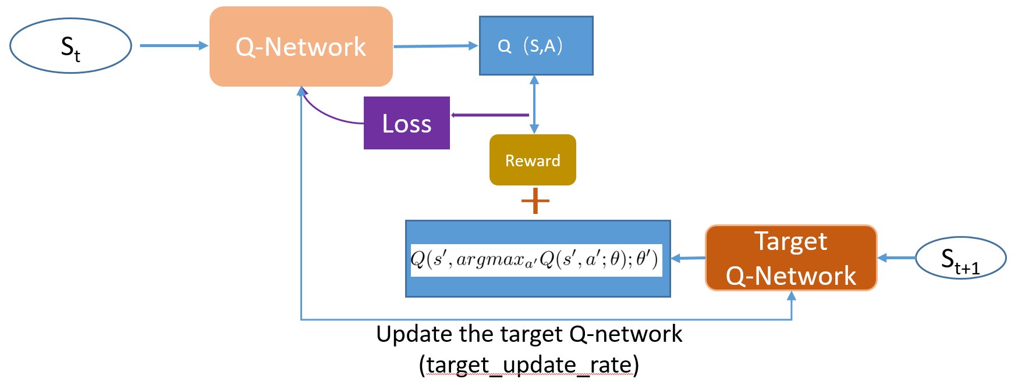
2. Value-based: DQN
Naïve DQN – Fixed DQN – Double DQN
Q-Network
Q（S,A）
S_{t}
Naïve DQN
Fixed DQN
S_{t+1}
Loss
Q（S_{t+1},A_{t+1}）
Reward
Double DQN
Double

Slide 7
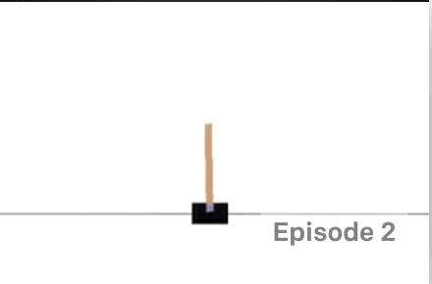
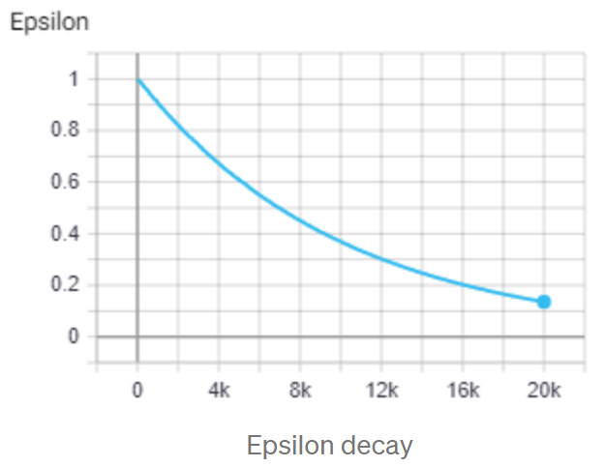
2. Value-based: DQN
Double DQN: CartPole
States:[pos, vel, theta, w_vel]
Action:[0: left, 1:right]
Replay buffer
transition(s,a,r,s’), memory_size，mini-batch
reward:[0: game over,
1: keep moving]
Epsilon Greedy (Exploration-- Exploitation)
Exploration
Random(0,1) < red point value
Exploitation
Random(0,1) > red point value
Interact with environment
Action→ Next state → reward → Done
Double NETWORK
Q-network (Fully connected) predicts value & target value
Notes:
Non-image
Replay buffer: transition,两点好处，sample efficiency & Independent and identically distributed IID
Q-network and target Q-network

Slide 8
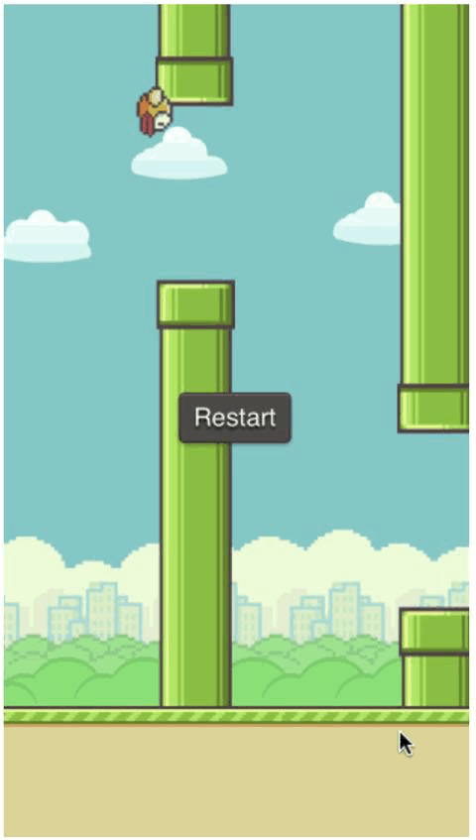
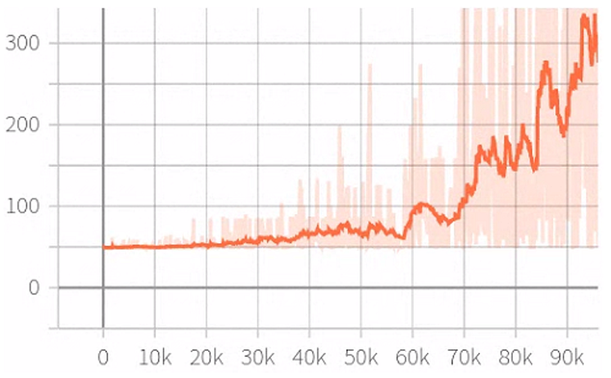
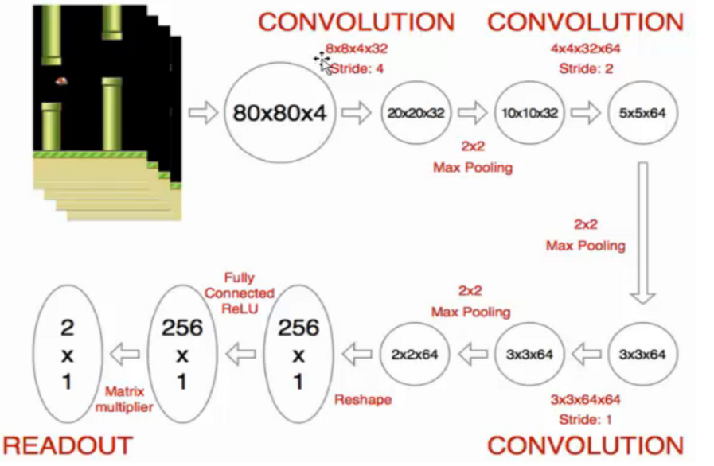
2. Value-based: DQN
Double DQN: Flappy bird (image)
States ?
Action ?
Reward ?
Done ?
DQN: CNN
Episode reward
Tricks:
HyperParameter:
Rgb image → gray image;
Resize image;
4 frame;
Max episode;
Memory size;
Batch size;
Epsilon decay;
Target network update;
Learning rate;
4 frames → CNN → CNN → CNN → FC → FC

Slide 9
2. Value-based: DQN
Carla step by step：
Create a Carla Environment;
Spawn a vehicle
Spawn a rgb-camera attaching to vehicle
Build a CNN network (input: image);
CNN network
State dimension and action dimension
Achieve Double DQN algorithm to train CNN network;
Epsilon-greedy policy – action;
Interact with env
Transition (s, a, r, s’)
Training network by replay buffer
Use the CNN (Policy) to control the vehicle;
Load the CNN params;
Interact with Carla env;
Notes:
DQN:训练网络使Q-value（state，action）
Why: double over-estimate …

Slide 10
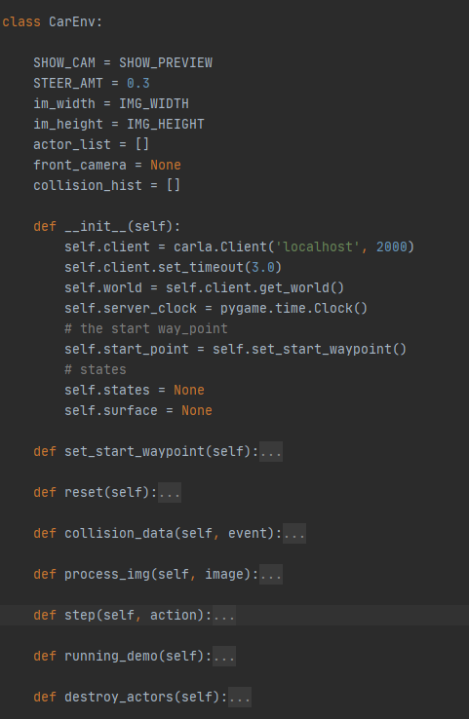
2. Value-based: DQN
Create a Carla Environment :
CarlaEnv Class:
Reset：spawn vehicle and sensor for each episode；
Collision_data: Vehicle have a collision and this episode is done;
Process_image: Record a env state;
Step: agent interacts with the Carla simulator;
Apply a control based on the action;
Design a reward for the action;
The episode is done or not;
Find the startpoint;
Destroy the actors (vehicle and sensor);
Notes:
Create Carla: 重点强调vehicle的生成位置和传感器的位置

Slide 11
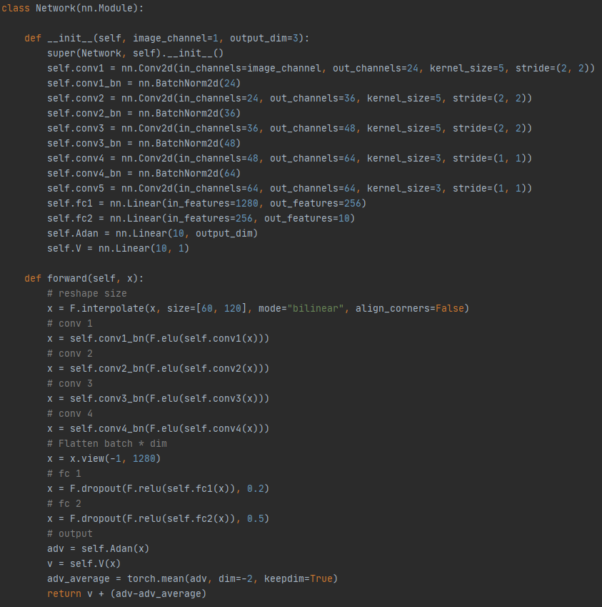
2. Value-based: DQN
Build a CNN network :
CNN + Fully Connected
Notes:
CNN网络强调：输入输出和 CNN – FullyConnect 拉平处理

Slide 12
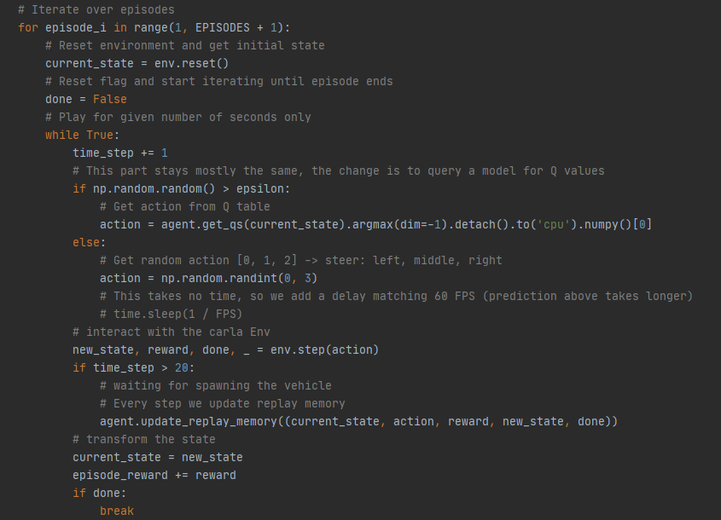
2. Value-based: DQN
Training Network by Double DQN:
Collect data
Obtain the current state
(rbg-image)
Epsilon-greedy
Agent interacts with Carla Env
Replay Buffer
Notes:
遵循三个主要的过程：
（1） loss function
（2） y_label: target_Qvalue
(3) replay buffer
讲清楚这三点，即可啊

Slide 13
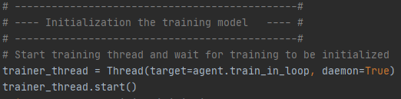
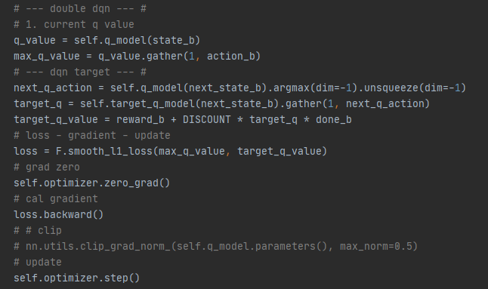
2. Value-based: DQN
Training Network by Double DQN:
Training Model
Multi Threads
Q-value(s, a)
Target Q-value
Loss function
Pytorch Gradient Descent
Notes:
遵循三个主要的过程：
（1） loss function
（2） y_label: target_Qvalue
(3) replay buffer
讲清楚这三点，即可啊

Slide 14
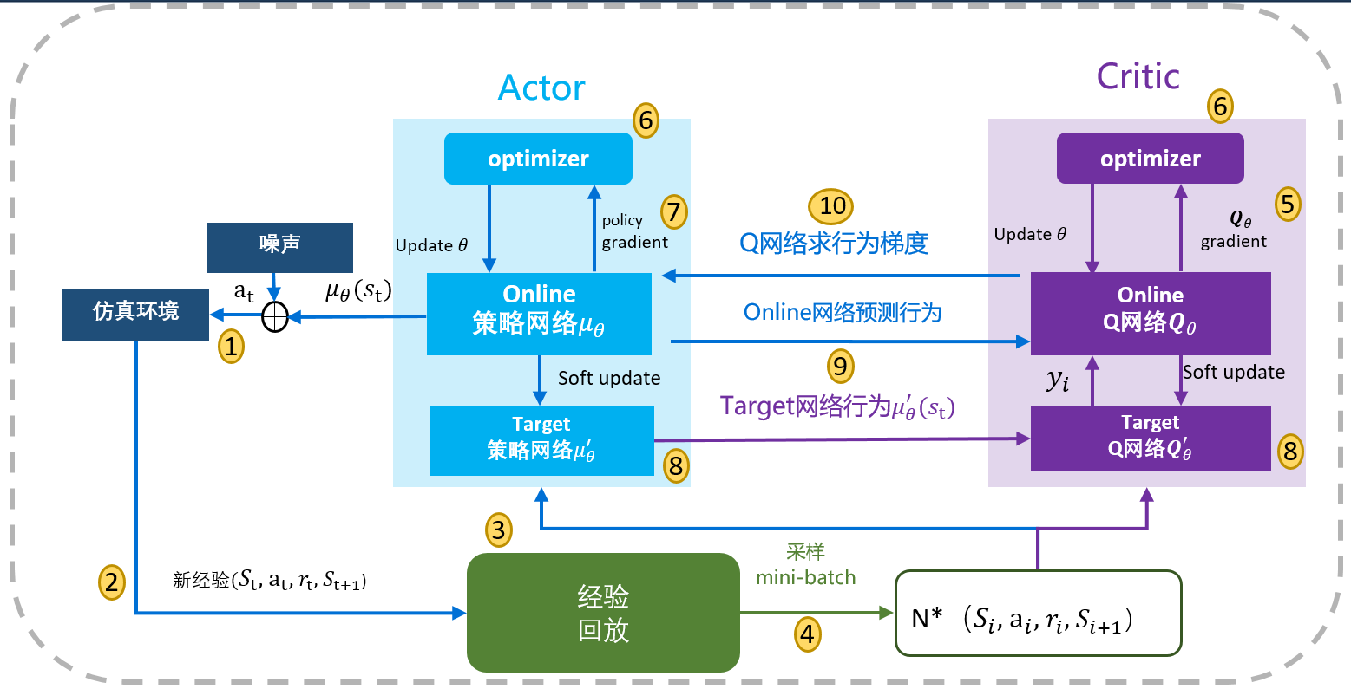
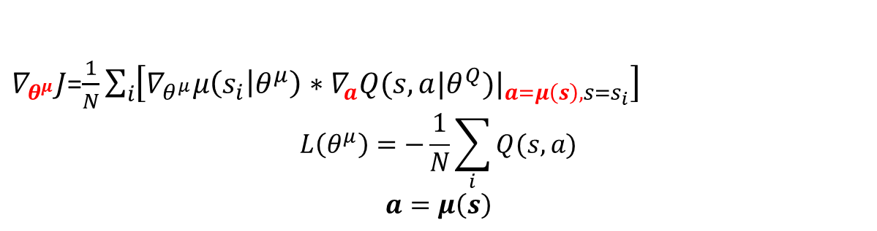
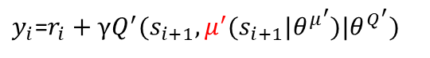
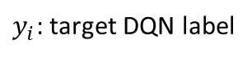
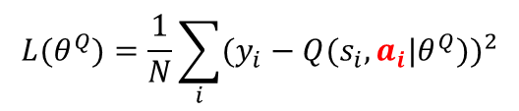
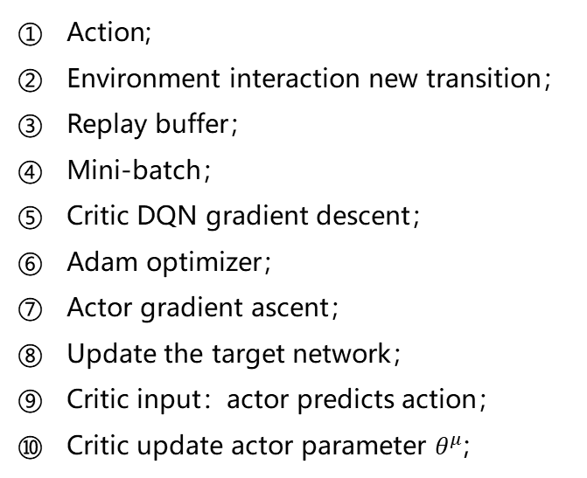
Deep Deterministic Policy Gradient (DDPG Policy Gradient )
DDPG
Action;
Environment interaction new transition；
Replay buffer；
Mini-batch；
Critic DQN gradient descent；
Adam optimizer；
Actor gradient ascent；
Update the target network；
Critic input：actor predicts action；
Critic update actor parameter $θ^{μ}$;
Critic DQN
Actor Policy Network
MSE：
$$L(θ^{Q})=\frac{1}{N}\sum_{i}{{(y_{i}−Q(s_{i},a_{i}|θ^{Q}))}^{2}}$$
$∇_{θ^{μ}}J$=$\frac{1}{N}\sum_{i}{\left[∇_{θ^{μ}}μ\left(s_{i} | θ^{μ}\right)∗{∇_{a}Q(s, a|θ^{Q})|}_{a=μ\left(s\right),s=s_{i}}\right]}$
$$L\left(θ^{μ}\right)=−\frac{1}{N}\sum_{i}{Q(s, a)}$$
$$a=μ\left(s\right)$$
$y_{i}$: target DQN label
$y_{i}$=$r_{i}+γQ^{′}(s_{i+1},μ^{′}(s_{i+1}|θ^{μ^{′}})|θ^{Q^{′}})$
Notes:
4个网络：actor， critic
Target，不更新参数，update rate；
Critic network input action
Policy network update
DQN, PG算法的巧妙结合，取长补短，连续行为，经验回放；

Slide 15
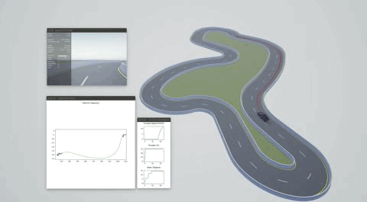
Project
Control Method
Goal
Keyboard;
PID;
Behavior Cloning;
Reinforcement learning (DQN);
Sensor
RGB-image;
Depth-image;
Lidar;

Slide 16
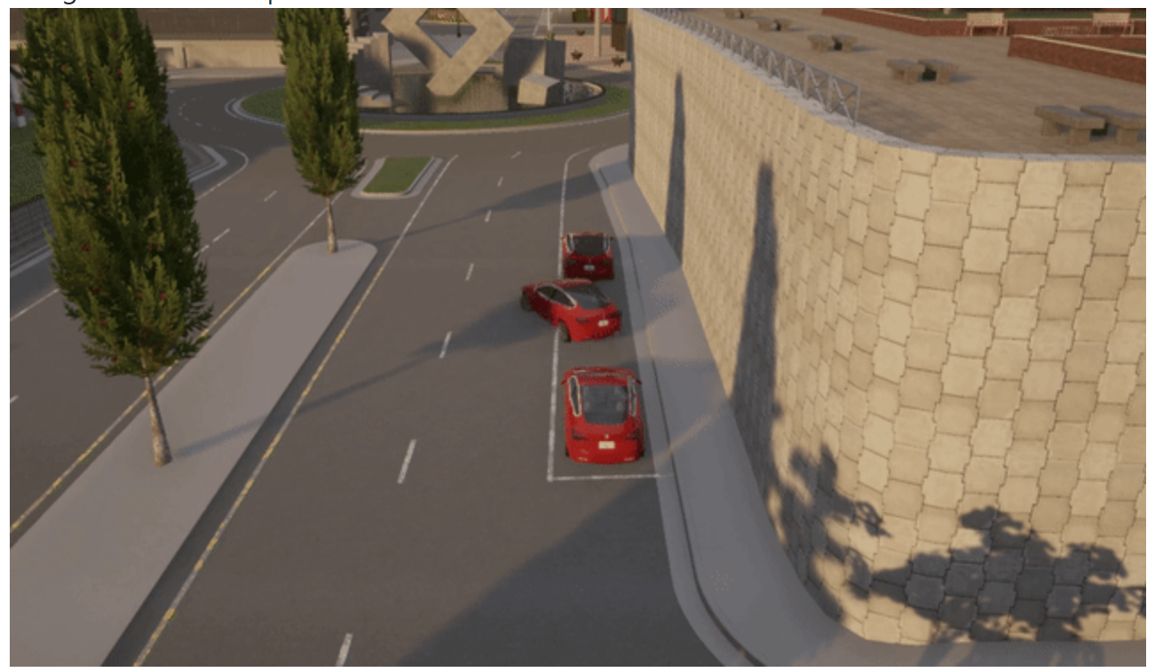
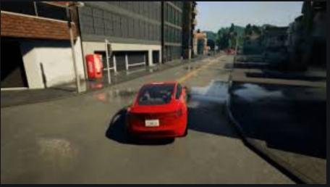
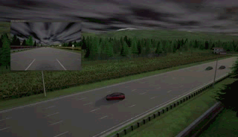
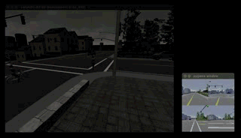
Just the beginning
Improve the RL control
Steer, Throttle, brake and more ;
Policy gradient ;
Autonomous driving license
Side parking ;
Reversing into the garage ;
Right angle bend;
Multi-agent
V2V ;
V2X ;

